Slide 1
Digital Image Processing Technologies & Applications
Morphological Image Processing

Slide 2

Contents
In this lecture we will consider
What is morphology?
Basic Concepts of Set Theory
Dilation and Erosion
Opening and Closing
Hit or Miss Transform

Slide 3
What Is Morphology?
Presented by J. Serra in 1964.
Morphological image processing (or morphology) describes a range of image processing techniques that deal with the shape (or morphology) of features in an image.
The basic idea of Morphology is to use a special structuring element to measure or extract the corresponding shape or characteristics in the input images for further image analysis and object recognition.
The mathematical foundation of morphology is the set theory.
In this chapter, the input images are binary images.

Slide 4
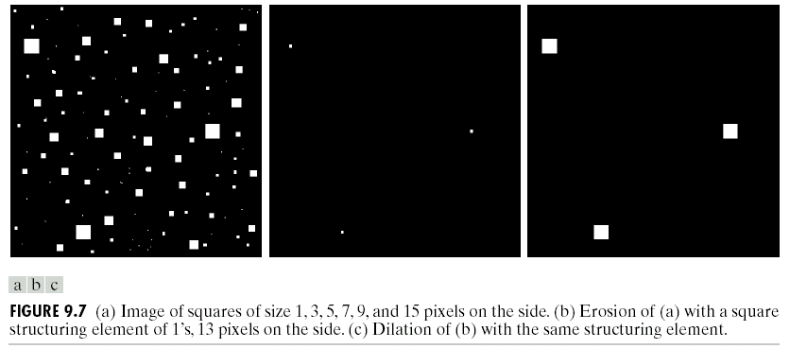
0, 1, Black, White?
Throughout all of the following slides whether 0 and 1 refer to white or black is a little interchangeable
All of the discussion that follows assumes that images are made up of 0s for background pixels and 1s for object pixels (foreground)
After this it doesn’t matter if 0 is black, white, yellow, green…….

Slide 5
Basic Concepts of Set Theory
A is a set, if a=(a₁,a₂) is an element of A, then, a∈A
If not, then, a∉A
∅: null (empty) set
Typical set specification:
C={w|w=-d, for d ∈D}
A
a
A
a

Slide 6
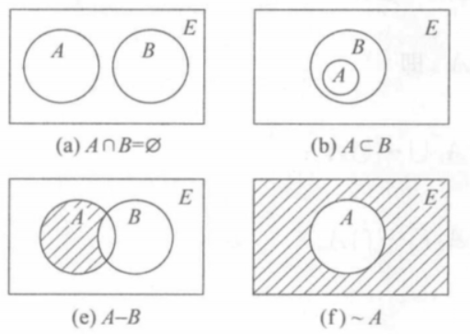
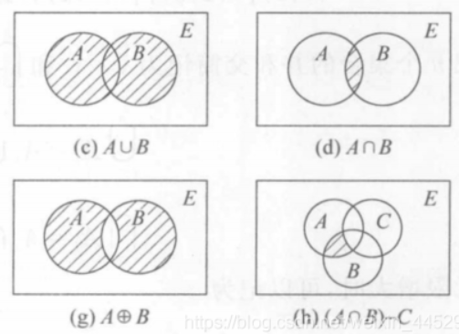
Basic Concepts of Set Theory
A subset of B: A⊆B
Union of A and B: C=A∪B
Intersection of A and B: D=A∩B
Disjoint sets: A∩B= ∅
Complement of A: A^{c}={w|w∉A}
Difference of A and B:
A-B={w|w∈A, w∉B}=A ∩B^{c}

Slide 7
Basic Concepts of Set Theory
Translation of A by z=(z₁,z₂):
(A)_{z}={w|w=a+z, a∈A}
Reflection of B:
B={w|w=-b, b∈B}

Slide 8
Structuring Element, Hit, Fit, & Miss
B
Structuring Element
Fit: for each of SE pixels set to 1, the corresponding image pixel is also 1.
Hit: at least one of SE’s pixels set to 1 the corresponding image pixel is also 1.
Miss: no pixel in the structuring element covers an on pixel in the image.
A
C
All morphological processing operations are based on these simple ideas

Slide 9
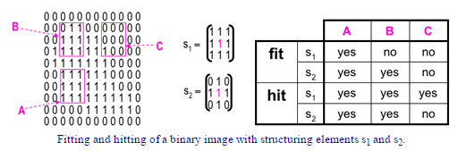
Fit, Hit, & Miss
0 | 0 | 0 | 0 | 0 | 0 | 0 | 0 | 0 | 0 | 0 | 0
0 | 0 | 0 | 1 | 1 | 0 | 0 | 0 | 0 | 0 | 0 | 0
0 | 0 | 1 | 1 | 1 | 1 | 1 | 0 | 0 | 0 | 0 | 0
0 | 1 | 1 | 1 | 1 | 1 | 1 | 1 | 0 | 0 | 0 | 0
0 | 1 | 1 | 1 | 1 | 1 | 1 | 1 | 0 | 0 | 0 | 0
0 | 0 | 1 | 1 | 1 | 1 | 1 | 1 | 0 | 0 | 0 | 0
0 | 0 | 1 | 1 | 1 | 1 | 1 | 1 | 1 | 0 | 0 | 0
0 | 0 | 1 | 1 | 1 | 1 | 1 | 1 | 1 | 1 | 1 | 0
0 | 0 | 0 | 0 | 0 | 1 | 1 | 1 | 1 | 1 | 1 | 0
0 | 0 | 0 | 0 | 0 | 0 | 0 | 0 | 0 | 0 | 0 | 0
1 | 1 | 1
1 | 1 | 1
1 | 1 | 1
0 | 1 | 0
1 | 1 | 1
0 | 1 | 0
B
C
S1
S2
A

Slide 10
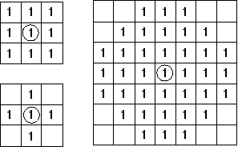
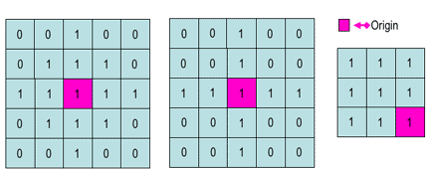
Structuring Elements
Structuring elements can be any size and make any shape.
Usually, element values are 0,1 and none(x).
Structural Elements have an origin.
For simplicity we usually use rectangular structuring, then we can take the middle pixel as its origin.
Empty spots in the Structuring Elements are don’t care’s!

Slide 11
Fundamental Operations
Fundamentally morphological image processing is very like spatial filtering.
The structuring element is moved across every pixel in the original image to give a pixel in a new processed image.
The value of this new pixel depends on the operation performed.
There are two basic morphological operations: dilation and erosion.

Slide 12
Dilation
Dilation of image f by structuring element s is given by f ⊕ s
The structuring element s is positioned with its origin at (x, y) and the new pixel value is determined using the rule:

Slide 13
Example for Dilation
Input image
1 | 0 | 0 | 0 | 1 | 1 | 1 | 0 | 1 | 1
Structuring Element
1
1
1
Output Image
 | 1

Slide 14
Example for Dilation
Input image
1 | 0 | 0 | 0 | 1 | 1 | 1 | 0 | 1 | 1
Structuring Element
1
1
1
Output Image
 | 1 | 0

Slide 15
Example for Dilation
Input image
1 | 0 | 0 | 0 | 1 | 1 | 1 | 0 | 1 | 1
Structuring Element
1
1
1
Output Image
 | 1 | 0 | 1

Slide 16
Example for Dilation
Input image
1 | 0 | 0 | 0 | 1 | 1 | 1 | 0 | 1 | 1
Structuring Element
1
1
1
Output Image
 | 1 | 0 | 1 | 1

Slide 17
Example for Dilation
Input image
1 | 0 | 0 | 0 | 1 | 1 | 1 | 0 | 1 | 1
Structuring Element
1
1
1
Output Image
 | 1 | 0 | 1 | 1 | 1

Slide 18
Example for Dilation
Input image
1 | 0 | 0 | 0 | 1 | 1 | 1 | 0 | 1 | 1
Structuring Element
1
1
1
Output Image
 | 1 | 0 | 1 | 1 | 1 | 1

Slide 19
Example for Dilation
Input image
1 | 0 | 0 | 0 | 1 | 1 | 1 | 0 | 1 | 1
Structuring Element
1
1
1
Output Image
 | 1 | 0 | 1 | 1 | 1 | 1 | 1

Slide 20
Example for Dilation
Input image
1 | 0 | 0 | 0 | 1 | 1 | 1 | 0 | 1 | 1
Structuring Element
1
1
1
Output Image
 | 1 | 0 | 1 | 1 | 1 | 1 | 1 | 1

Slide 21
Dilation Example
Original Image
Processed Image
Structuring Element

Slide 22
Dilation Example
Original Image
Processed Image With Dilated Pixels
Structuring Element

Slide 23
Dilation
B is the structuring element in dilation.
Dilation:
B is often called the “structuring element”
Process consists of obtaining the reflection of B, about its origin
Then shifting this reflection, B, by x
The dilation of A by B is the set of all x, displacements such that B and A overlap by at least one element

Slide 24
Dilation Example
Original Image
Processed Image
Structuring Element

Slide 25
Dilation Example
Original Image
Processed Image
?
Note: For each structuring element, we should given a origin point. The origin point can be inside or outside the structuring element. The result should be different for different origin point.
Structuring Element

Slide 26
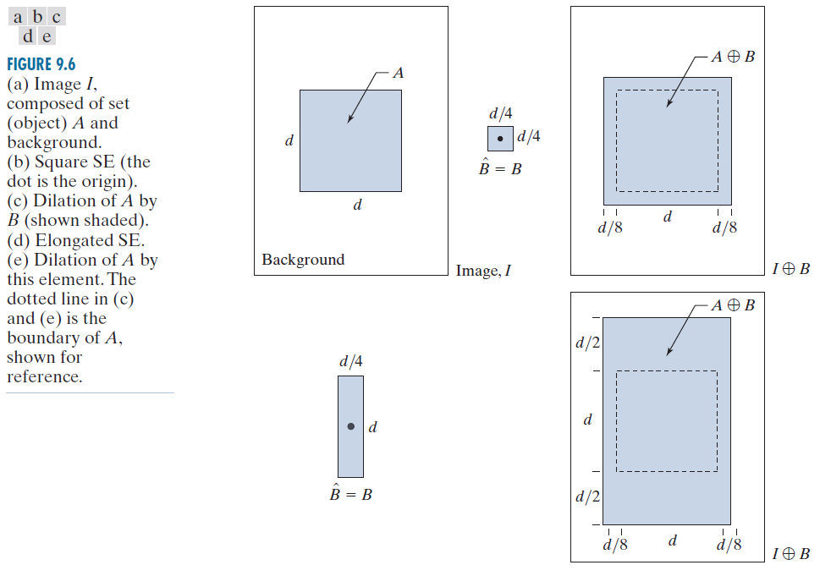
Dilation Example

Slide 27

Dilation Example 1
Original image
Dilation by 3*3 square structuring element
Dilation by 5*5 square structuring element

Slide 28
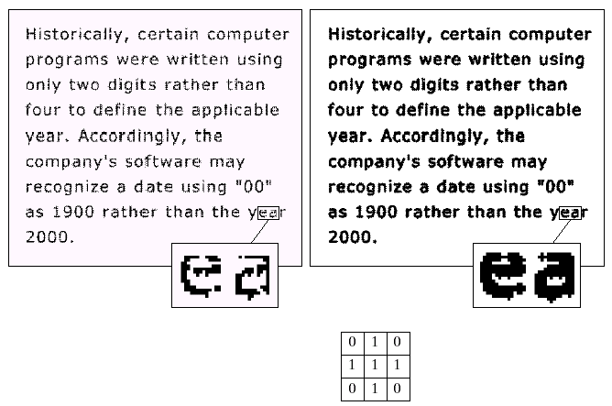
Dilation Example 2
Original image
After dilation
Familiar with low pass filter.
Structuring element
Dilate.m

Slide 29
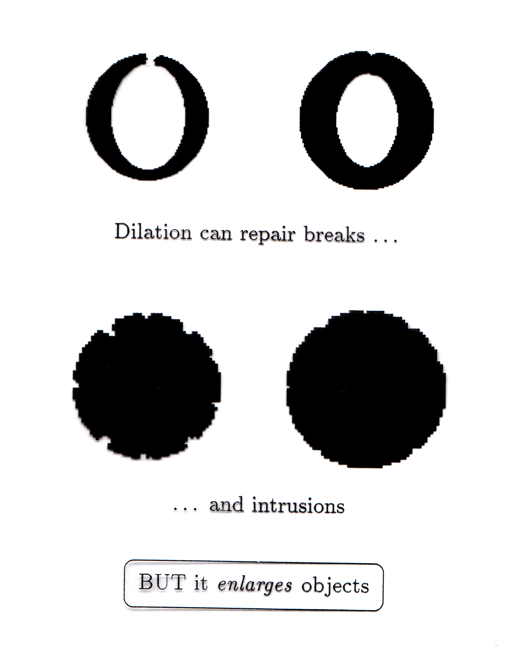
What Is Dilation For?
Dilation can repair breaks
Dilation can repair intrusions
Watch out: Dilation enlarges objects

Slide 30
Erosion
Erosion of image f by structuring element s is given by f  s
The structuring element s is positioned with its origin at (x, y) and the new pixel value is determined using the rule:

Slide 31
Example for Erosion
Input image
1 | 0 | 0 | 0 | 1 | 1 | 1 | 0 | 1 | 1
Structuring Element
1
1
1
Output Image
 | 0

Slide 32
Example for Erosion
Input image
1 | 0 | 0 | 0 | 1 | 1 | 1 | 0 | 1 | 1
Structuring Element
1
1
1
Output Image
 | 0 | 0 | 0 | 0 | 1 | 0 | 0 | 0

Slide 33
Erosion Example
Original Image
Processed Image
Structuring Element

Slide 34
Erosion
i.e. the erosion of A by B is the set of all points x such that B, translated by x, is contained in A.

Slide 35
Erosion Example
Original Image
Processed Image
Structuring Element: The origin point can be inside or outside the structuring element

Slide 36
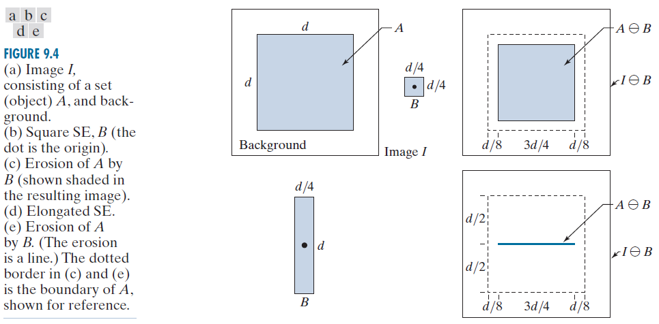
Erosion Example

Slide 37

What Is Erosion For?
Original image
Erosion by 3*3 square structuring element
Erosion by 5*5 square structuring element

Slide 38
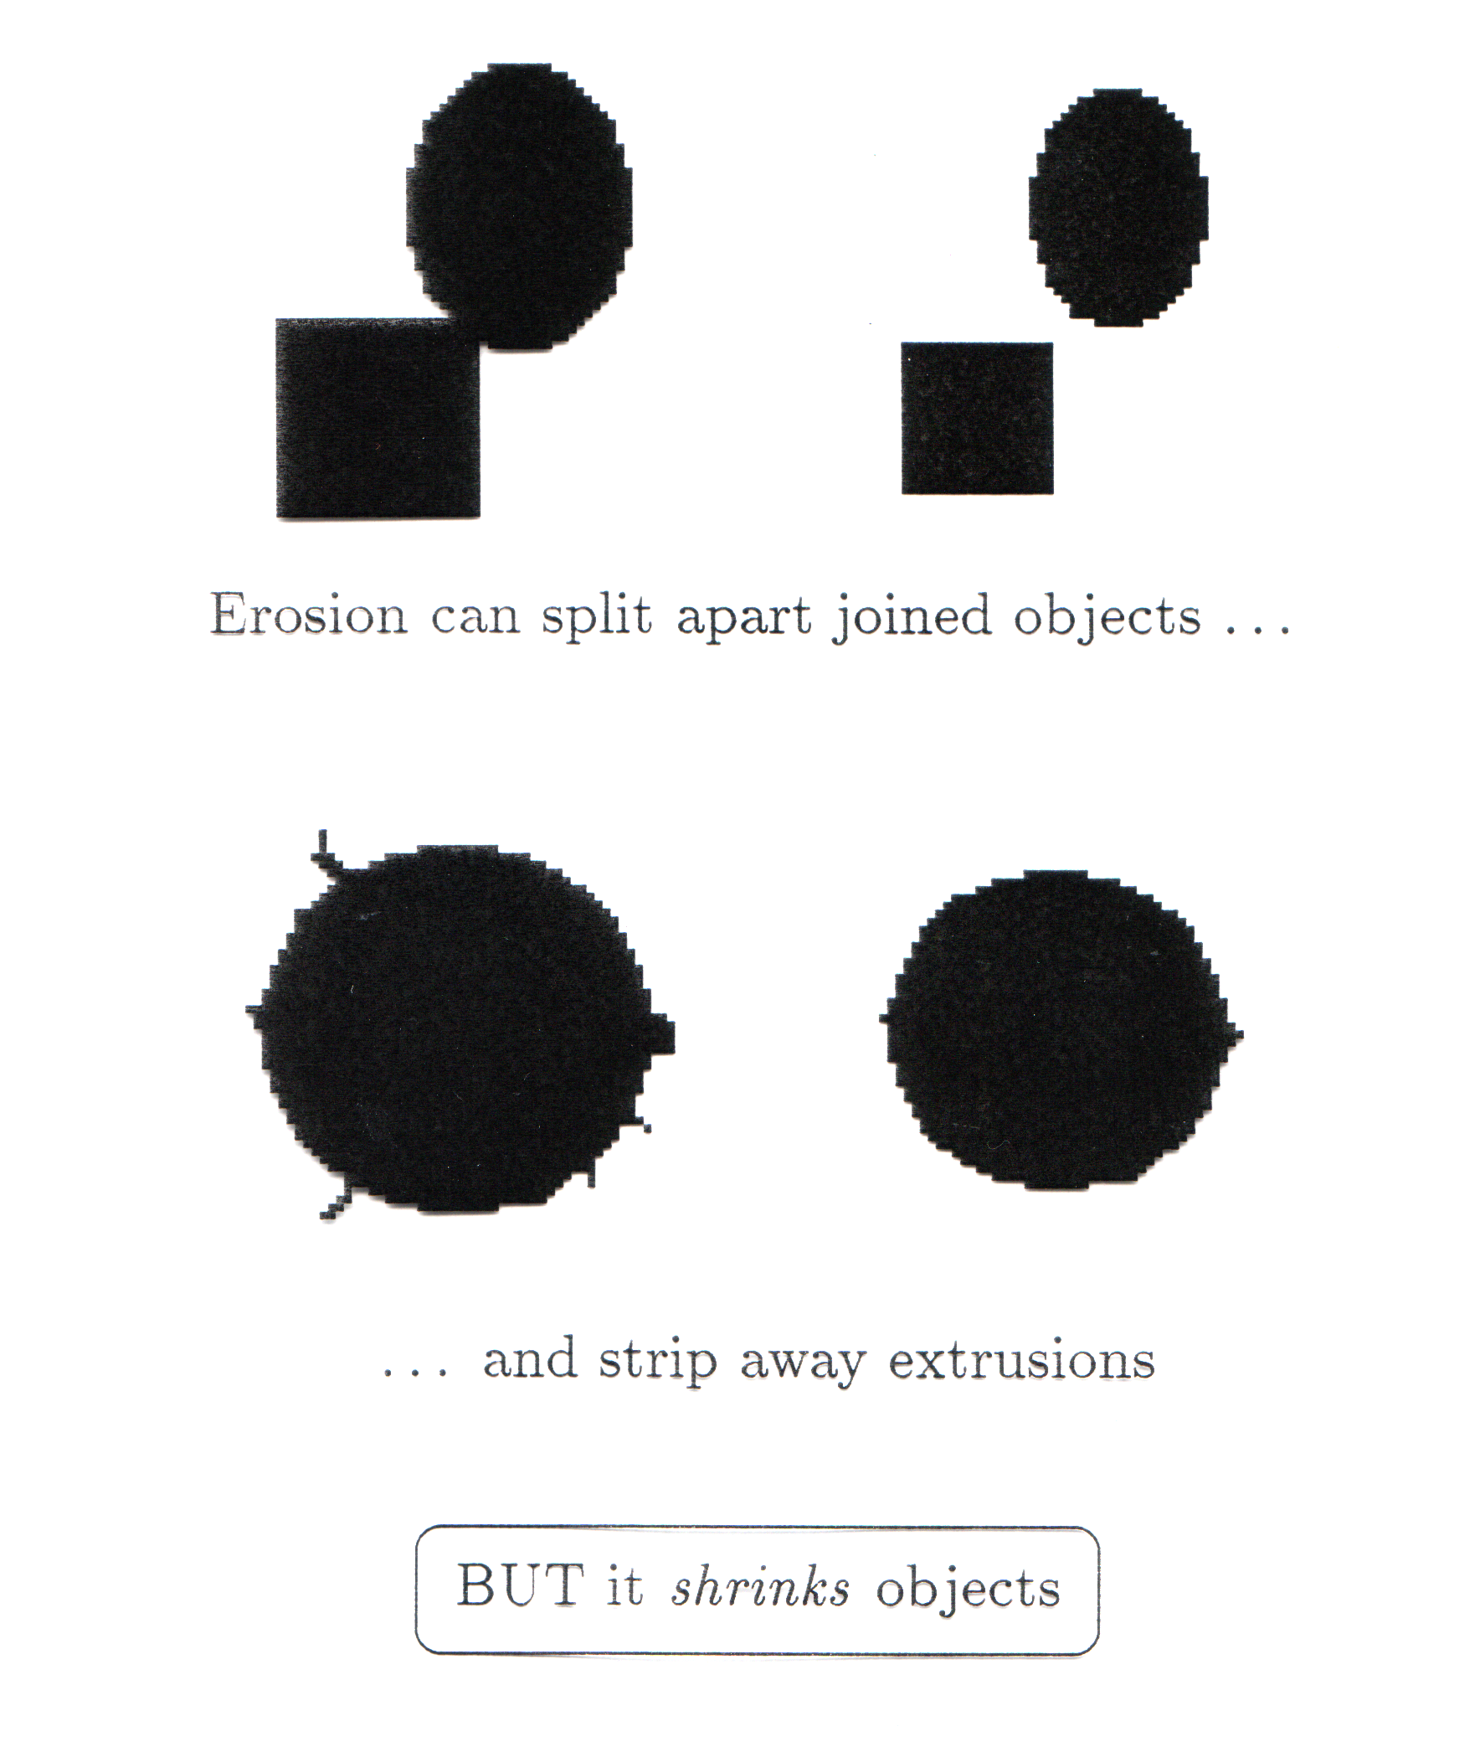
What Is Erosion For?
Erosion can split apart joined objects
Erosion can strip away extrusions
Watch out: Erosion shrinks objects

Slide 39
Erosion Example
Use of morphological erosion for removing image components
Erose.m, size of structuring element is 13*13

Slide 40

Erosion Example
Original image
After erosion with a disc of radius 10
After erosion with a disc of radius 5
After erosion with a disc of radius 20

Slide 41
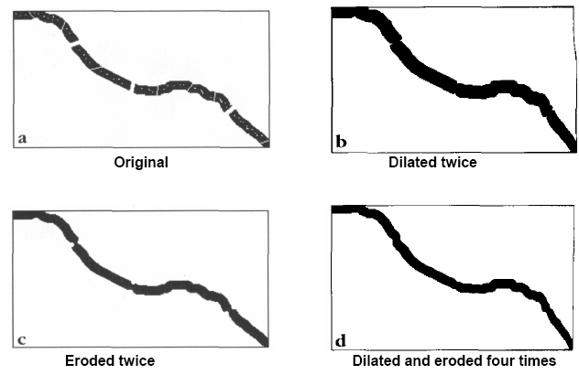
Erosion & Dilation Application
Object connection：

Slide 42
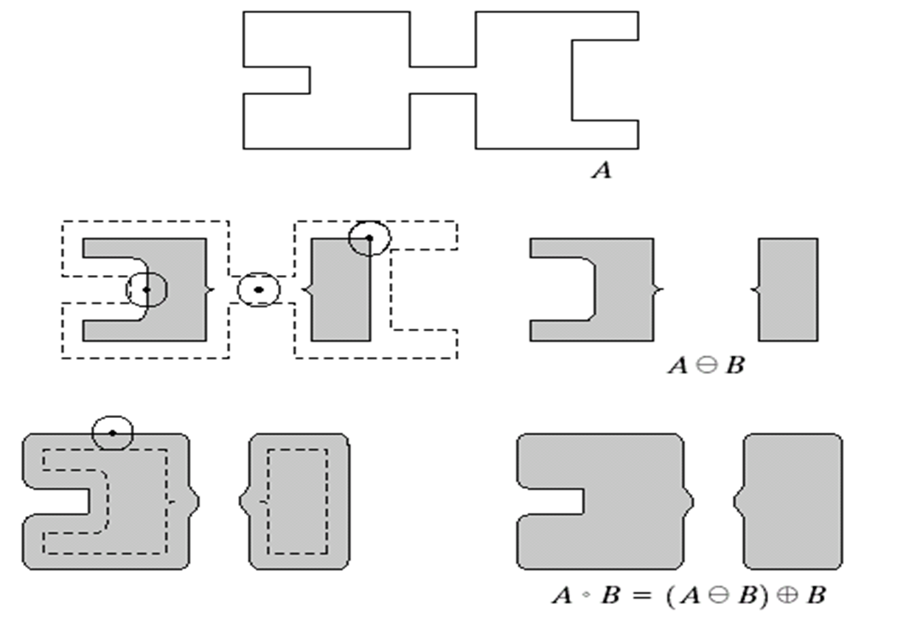
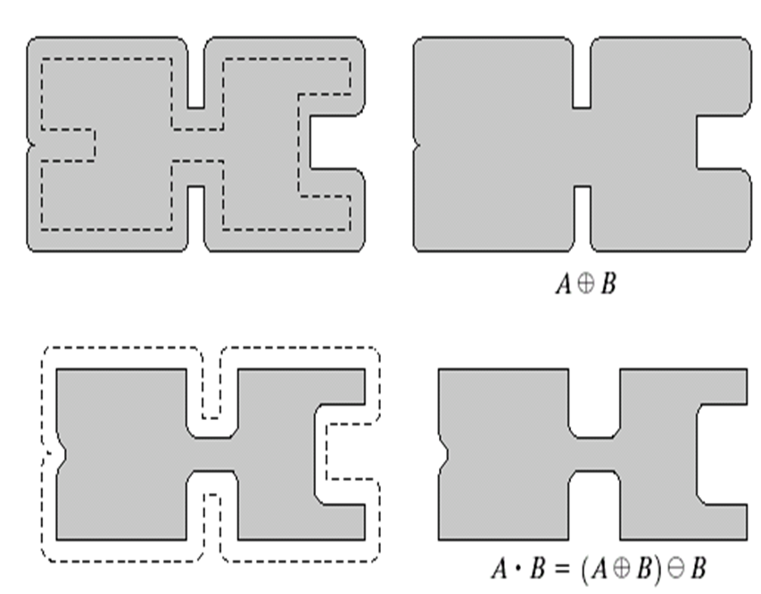
Compound Operations
More interesting morphological operations can be performed by performing combinations of erosions and dilations
The most widely used of these compound operations are:
Opening
Closing

Slide 43
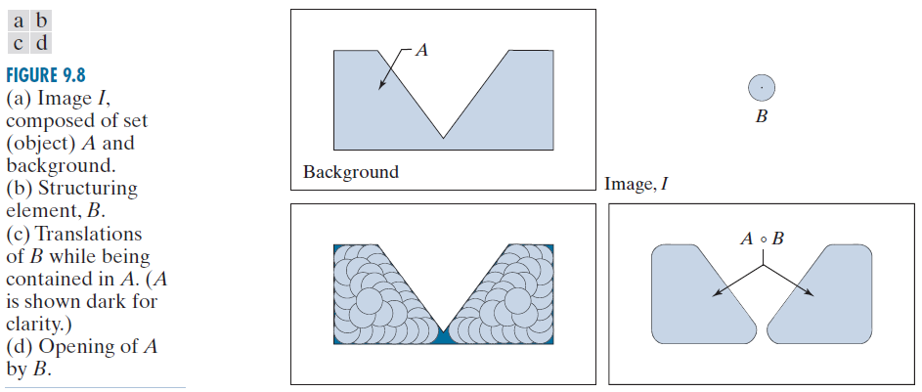
Opening
The opening of image f by structuring element s, denoted f ○ s is simply an erosion followed by a dilation
f ○ s = (f s) ⊕ s

Slide 44
Opening Example
Original Image
After erosion
Structuring Element

Slide 45
Opening Example
After erosion
After dilation

Slide 46
Opening Example
Original Image
Processed Image
Original Image
Structuring Element

Slide 47
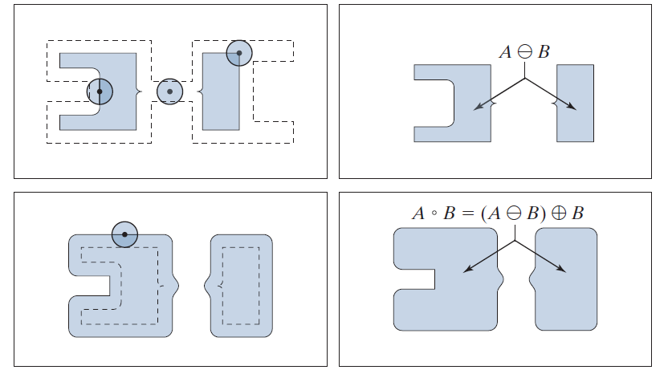
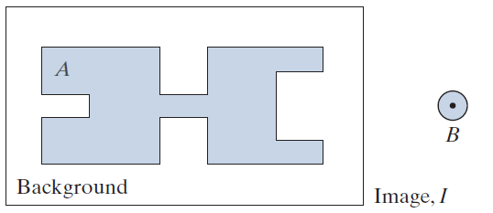
Opening

Slide 48

Opening Example
Original Image
Image After Opening

Slide 49
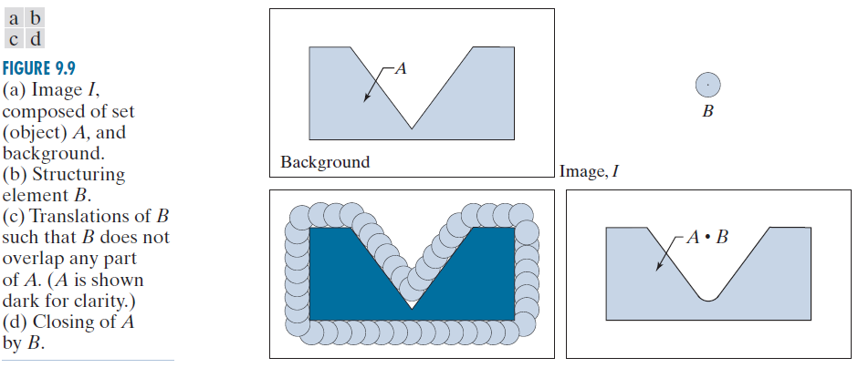
Closing
The closing of image f by structuring element s, denoted f • s is simply a dilation followed by an erosion
f • s = (f ⊕s) s

Slide 50
Closing Example
After dilation
Structuring Element

Slide 51
Closing Example
After dilation
After erosion
Structuring Element

Slide 52
Closing Example
Original Image
Processed Image
closing
Structuring Element

Slide 53
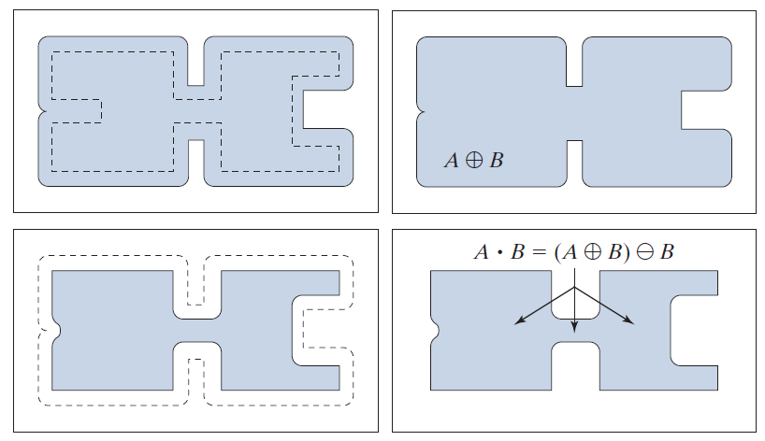
Closing

Slide 54
Closing Example
Original Image
Image After Closing

Slide 55
Properties of Opening and Closing
Opening
-A○B is a subset of A
-If C is a subset of D, then C○B is a subset of D○B
-(A○B)○B=A○B
Closing
-A is a subset of A • B
-If C is a subset of D, then C • B is a subset of D • B
-(A • B) • B=A • B

Slide 56
Opening & Closing
In essence, dilation expands an image and erosion shrinks it.
Opening:
generally smoothes the contour of an image, breaks thin connections, eliminates protrusions.
Closing:
smoothes sections of contours, but it generally fuses breaks, holes, gaps, etc.

Slide 57
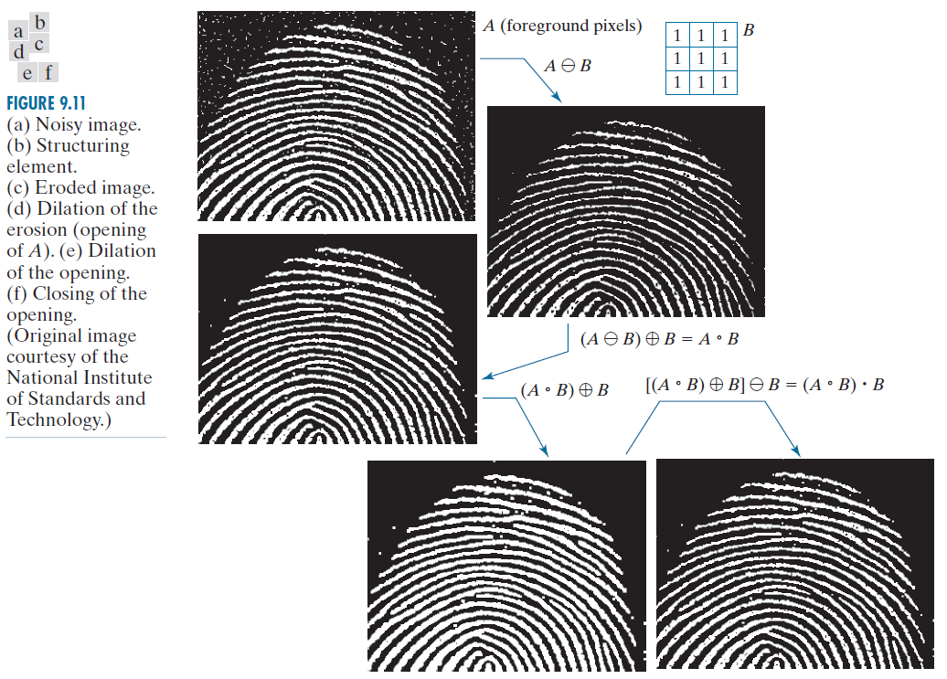
Morphological Processing Example
Openandclose.m

Slide 58
Morphological Processing Example

Slide 59
Hit-or-Miss Transform
Morphological hit-or-miss transform is a basic tool for shape detection.
Construct two elements
X and (W-X ) where W is window slightly larger than X
Our goal is to find X in the image
Solution: if B denotes the set composed of X and its background, the match of B in A, is:

Slide 60
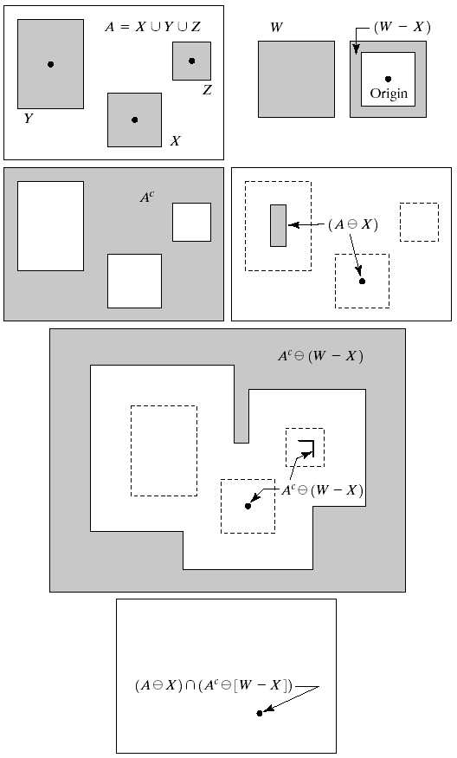
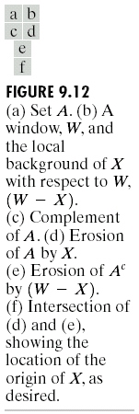
Hit-or-Miss Transform

Slide 61
Hit-or-Miss Transform
Definitions:
B → (B₁,B₂)
B₁ is the set of elements of B associated with an object
B₂ is the set of elements of B associated with the corresponding background.
B₁ =X, B₂=W-X

Slide 62
Hit-or-Miss Transform
B₁ =X, B₂=W-X
B₁
B₂

Slide 63
Hit-or-Miss Transform
B₁
B₂

Slide 64
Hit-or-Miss Transform

Slide 65
Hit-or-Miss Transform

Slide 66
Hit-or-Miss Transform
If we define a structuring element, B, identical to X, but having in addition a border of background elements with a width of one pixel. We can use a structuring element formed in such a way to restate the hit-or-miss transform as:
The form is the same as erosion. but now we see the structuring element is composed of both foreground and background pixels

Slide 67
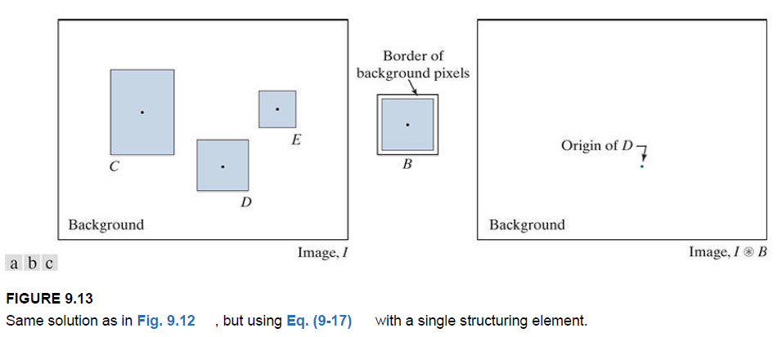
Hit-or-Miss Transform

Slide 68
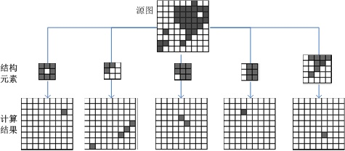
Hit-or-Miss Transform
Sometimes, we want to match the pattern (not an object) in one image, then, the hit-or-miss transform is similar to erosion operation
Different SE will get different results.

Slide 69
Summary
The purpose of morphological processing is primarily to remove imperfections added during segmentation.
The basic operations are dilation and erosion.
Using the basic operations we can perform opening and closing.
More advanced morphological operation can then be implemented using combinations of all of these.

